Slide 1

Transformer SR Survey
Debasish Dutta, Deepjyoti Chetia , Neeharika Sonowal and Sanjib Kr Kalita
TM
Problem Statement: Despite rapid progress in Transformer-based Super-Resolution (SR), there is no comprehensive review that organizes and compares these models — including pure-transformer designs, hybrid approaches, and domain-specific optimizations. This gap leaves researchers without a clear roadmap for understanding strengths, weaknesses, and trade-offs across models
Proposed Approach: A taxonomy of SR models is proposed, along with comparative tables summarizing metrics across datasets. The review identifies open challenges and emerging directions, such as lightweight Transformer SR and domain-specific adaptations.
From CNNs & GANs to Transformers:
Captures global context – Self-attention models relationships across the entire image, unlike CNNs with limited receptive fields.
Recovers fine textures – Preserves high-frequency details more accurately than GANs, which may hallucinate artifacts.
Adaptive attention mechanism – Dynamically focuses on important regions, unlike CNNs with fixed-size kernels.
Supports multiple tasks – A single transformer can handle SR, denoising, and deblurring without major redesign.
Conclusion :
Even though transformer SR has advanced a lot, challenges remain:
High memory and computation requirements
Dependence on large datasets
Difficulty with fine textures in complex images
Slow inference for real-time use
Challenges in Transformer-based SR
High Memory & Computation Cost – Transformers require large GPU memory and heavy computation, making real-time use difficult.
Large Data Dependency – Performance often drops without huge training dataset
Fine-Texture Preservation – Maintaining sharp, high-frequency details in complex scenes is still hard.
Slow Inference Speed – High latency prevents use in real-time or edge applications.
Future models should be:
Lightweight and efficient
Able to handle many types of degradation
Potentially combine classical methods (wavelets, interpolation) with deep learning
Objective:
Analyze Transformer-based SR models, their core components, and differences from CNNs.
Compare datasets, metrics, and each model’s strengths, weaknesses, and trade-offs.
Provide a structured foundation for future work in SR.
Methodology:
Conducted a systematic literature review of SR transformer models.
Categorized models by architecture (ViT, Swin, hybrid, encoder-decoder, deformable attention).
Compared models using PSNR, SSIM, parameters, and FLOPs.
Reviewed SR loss functions (pixel, perceptual, adversarial, texture, combined).

Slide 2
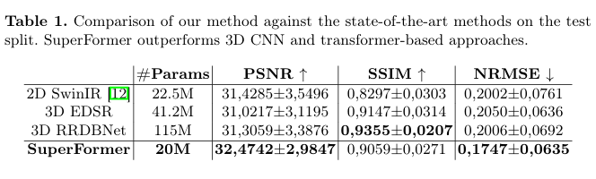
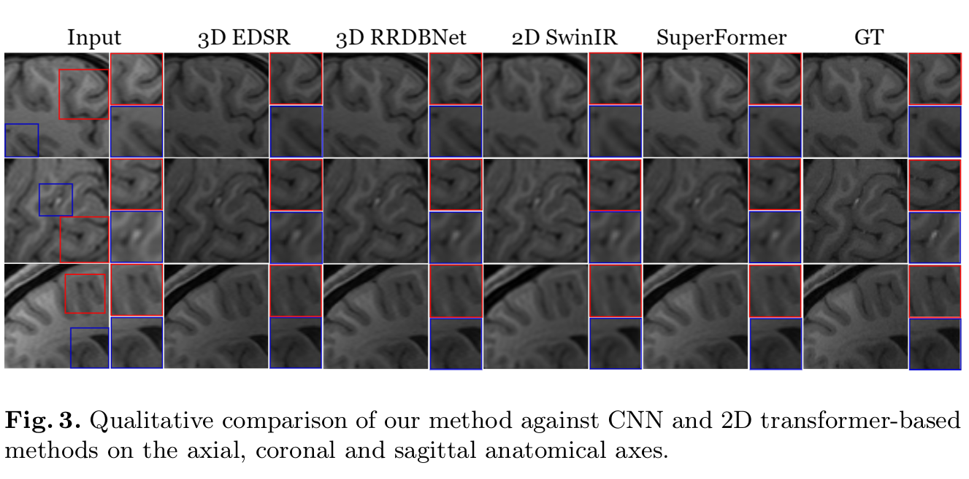
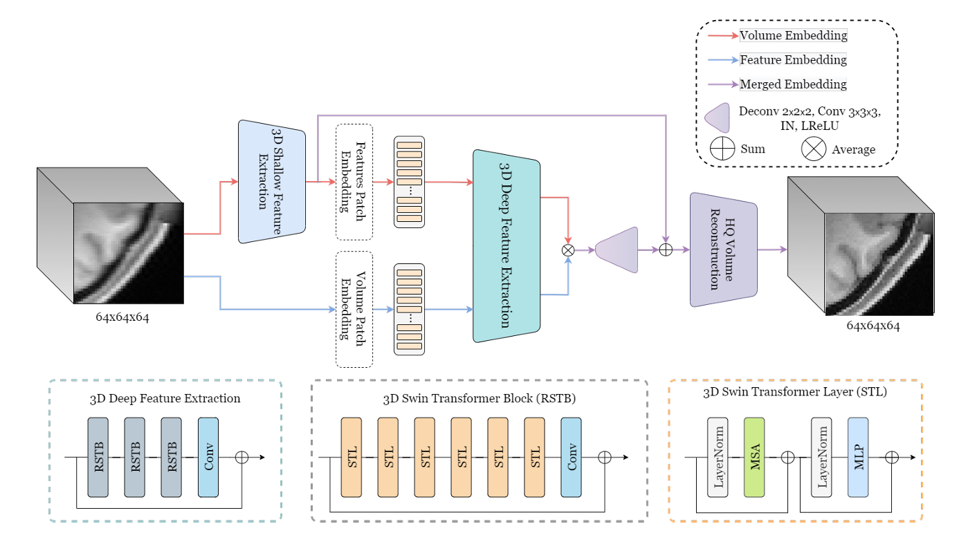
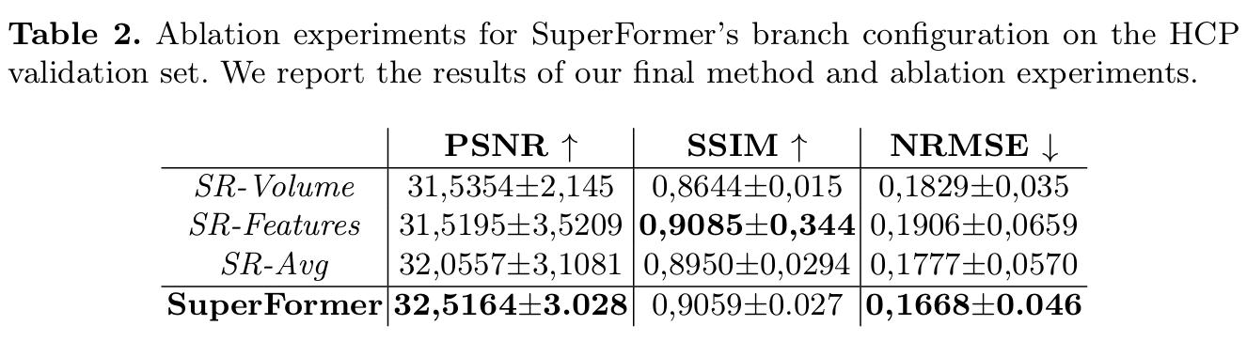
Superformer
Cristhian Forigua, Maria Escobar, Pablo Arbelaez
TM
Problem Statement: High-resolution MRI provides vital anatomical details but is costly and time-consuming. Volumetric super-resolution offers a way to generate high-resolution scans from low-resolution inputs while keeping their speed and affordability.
Proposed Approach: SuperFormer generalizes the Swin Transformer to the 3D medical domain for MRI super-resolution. It uses volumetric attention with 3D relative positional encoding to capture structural details. By combining feature and volume embeddings, the model produces sharper, more accurate reconstructions than single-domain methods
Results:
Objective:
Leverage Vision Transformers (ViTs) in the 3D medical imaging domain.
Extend Swin Transformer to volumetric MRI super-resolution.
Demonstrate superiority over 3D CNN-based methods.
Embedding: Split MRI into 3D tokens and embed.
Feature Extraction: Apply 3D shifted window attention in Swin blocks.
Reconstruction: Fuse features to generate HR MRI.
Architecture:
Methodology:
Extract 3D tokens from MRI volumes and embed them for transformer processing.
Apply 3D shifted window attention in Swin blocks for volumetric feature learning.
Fuse shallow and deep features from both feature and volume embeddings to reconstruct HR MR
Conclusion:
SuperFormer outperforms CNNs and 2D transformers by leveraging 3D volumetric information. Its multi-domain design improves accuracy and perceptual quality, providing a strong foundation for future medical imaging research.

Slide 3
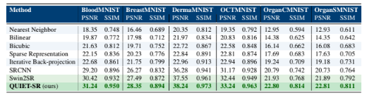
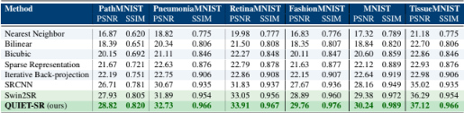
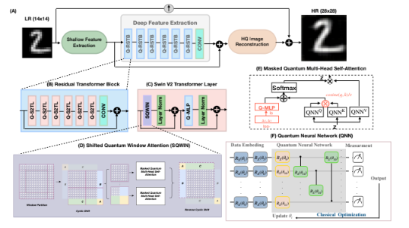
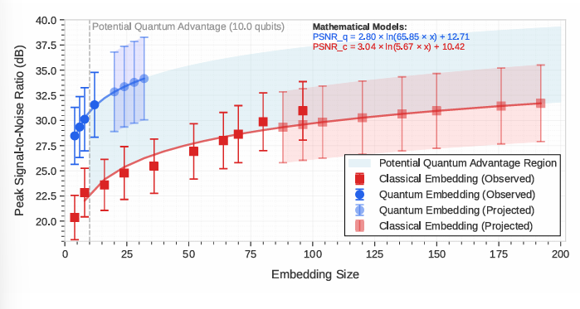
QUIET-SR
Siddhant Dutta, Nouhaila Innan, Khadijeh Najafi, Sadok Ben Yahia, Muhammad Shafique
TM
Problem Statement: Classical SR methods are computationally expensive, while quantum computing approaches face scalability limitations. Bridging these paradigms requires careful integration to exploit quantum advantages without overwhelming current hardware limits.
Proposed Approach: The hybrid architecture alternates between quantum and classical operations. The SQWIN design shifts attention windows to model cross-region dependencies, enhancing detail reconstruction without inflating parameter counts.
Results:
Objective:
Combine quantum and classical components to leverage their complementary strengths.
Adapt the model to NISQ hardware limits while maintaining competitive SR performance.
Architecture:
Methodology:
A Swin Transformer backbone is augmented with Shifted Quantum Window Attention (SQWIN) modules.
Quantum layers capture spatial relations efficiently and classical layers refine the reconstruction
Conclusion:
The method achieves near-SOTA PSNR/SSIM on small datasets (MNIST, FashionMNIST, MedMNIST) with significantly fewer parameters, demonstrating the feasibility of quantum-enhanced SR..

